Slide 1
CSV Plotter User Manual
9/20/16

Slide 2
CSV Plotter User Manual
Introduction:
CSV Plotter is a program designed to take CSV data and convert into a presentation quality line graph and/or bar graph output to a png file. This program was written in Python and can be run using a command line editor. This program consists of 2 files, a configuration file: csv_plotter_config.yml, program file: csv_plotter_v2.py
Table of Contents:
Installation Guide Page: 2
Configuration File Guide Page: 6
Program Execution Guide Page: 19

Slide 3
CSV Plotter User Manual
Installation Guide

Slide 4
CSV Plotter User Manual
Installation Guide:
Place the configuration file: csv_plotter_config.yml and the program file: csv_plotter_v2.py into the desired folder. Note: Please make sure both files are in the same folder, otherwise the program will not work.
For Windows Installations:
Download Anaconda from https://www.continuum.io/downloads Anaconda is a python download that contains all of the libraries needed to run CSV_Plotter
Choose to download either the 64bit or 32bit version of Python 3.5 version depending on your computer, then follow the prompts

Slide 5
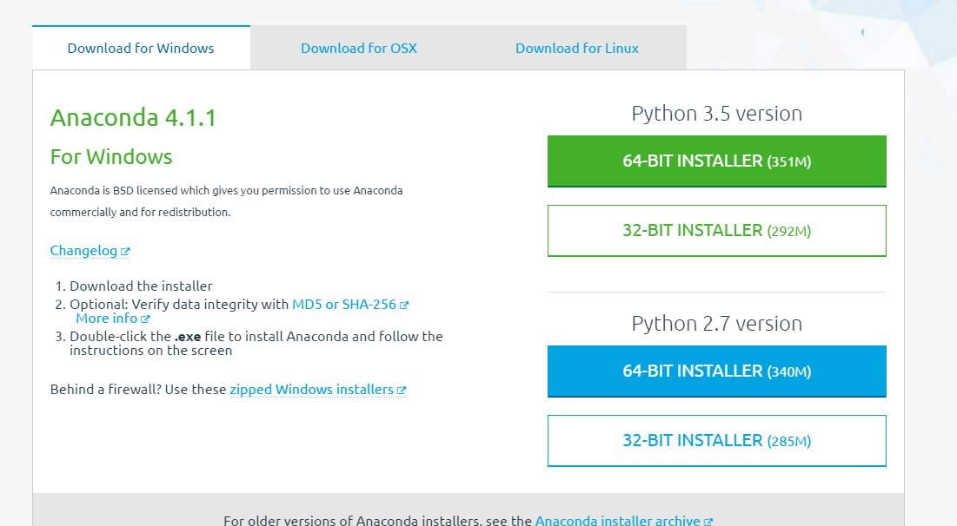
CSV Plotter User Manual
Click here for 64 bit
Version.

Slide 6
CSV Plotter User Manual
For Ubuntu Installations:
Most Ubuntu installations will have python pre-installed with the operating system. In order to run this program the matplot library will need to be installed
Open a Terminal window and type: sudo apt-get install python-pip
Press enter then type: sudo pip install matplotlib
Press enter and installation is complete

Slide 7
CSV Plotter User Manual
Configuration File Guide

Slide 8
CSV Plotter User Manual
Configuration File Guide:
The configuration file is the location where all of the programs settings are determined. To edit the configuration file, open in notepad csv_plotter_config.yml. Please note, the layout of configuration file is important and should not be changed. The only area that should be changed by the user is the text held within quotes.

Slide 9
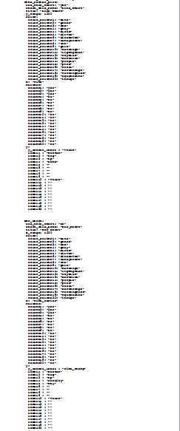
CSV Plotter User Manual
The configuration file is made up of 2 main sections separated by white space:
Line Graph Section
Bar Graph Section

Slide 10

CSV Plotter User Manual
Source_file_name : "barry.csv“ The first line is used by both graphing sections and determines what file is used for the csv input. The file must be in CSV format and must be located in the same folder as the csv_plotter_v2.py file.

Slide 11

CSV Plotter User Manual
Time_series_plot : This section controls the settings for the line chart function of the program
chart_file_name: "Line_Chart" This line assigns the file name for the png graph picture that will be saved into the same folder that contains the config file. Please note, unless the file name is changed between execution runs of the program, the png file will save over any previous images with the same name.

Slide 12

CSV Plotter User Manual
Use_this_chart: This line toggles the line chart on and off. To use this chart change the text in quotes to “yes’’, to not plot a line chart change the text to “no”. Be sure to type yes in lower case or the graph will not be created.

Slide 13

CSV Plotter User Manual
chart_file_name: This line assigns the file name the png graph picture will be saved as

Slide 14

CSV Plotter User Manual
title: "Line Chart“ This line sets the chart’s title

Slide 15

CSV Plotter User Manual
Y_range: This line sets the value range for the y axis. To change the value range, change the number to the value desired. Please note this value needs to be a whole number and is not limited to any particular upper level.

Slide 16
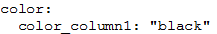
CSV Plotter User Manual
Color: This line sets the color of each of the value sets for example: color_column1: ‘black’ To change the color, change the text within the quote marks. Each color column number corresponds to the data set with the same column number. For a list of available colors, please visit: http://matplotlib.org/examples/color/named_colors.html

Slide 17

CSV Plotter User Manual
x: This line sets the axis name for the x axis. To change the axis name, change the text in the quotes

Slide 18

CSV Plotter User Manual
columns: This section determines what data is included in the graph. Beginning from the left column, count to the column you would like to use (be sure to begin counting with 0 NOT 1) For example you can choose the second column by changing column 1 to “yes” CAUTION!: if you receive an error, you might have chosen a column that has no data, double check that you chose a populated column. In addition all columns used must be the same length or an error will occur.

Slide 19

CSV Plotter User Manual
Y: This segment sets the Y axis settings
y_access_label : ‘Y-axis’: This line sets the y label for the y axis. To change the label, change the text in quotes.

Slide 20

CSV Plotter User Manual
label1 : ‘Custom’: This line changes the legend for data set 1. To change the legend, change the text in quotes.

Slide 21
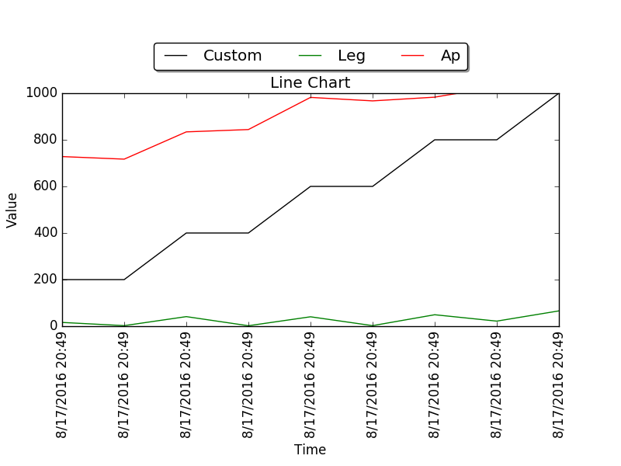
CSV Plotter User Manual
Label1: p20 / color: p16
title: p14
y_range: p15
y_access_label: p19
x: p17

Slide 22

CSV Plotter User Manual
bar_chart: This section controls the settings for the bar chart function of the program
Use_this_chart: This line toggles the bar chart on and off. To use this chart change the text in quotes to “yes”, to not plot a line chart change the text to “no”. Be sure to type yes in lower case or the graph will not be created.

Slide 23

CSV Plotter User Manual
chart_file_name: “Bar_Chart" This line assigns the file name for the png graph picture that will be saved into the same folder that contains the config file. Please note, unless the file name is changed between execution runs of the program, the png file will save over any previous images.

Slide 24

CSV Plotter User Manual
title: "Bar Chart“: This line sets the chart’s title

Slide 25

CSV Plotter User Manual
x_range: This line sets the value range for the x axis. To change the value range, change the number to the value desired. Please note this value needs to be a whole number and is not limited to any particular upper level.

Slide 26
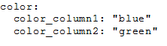
CSV Plotter User Manual
Color: This line sets the color of each of the value sets for example: color_column1: ‘black’ To change the color, change the text within the quote marks. Each color column number corresponds to the data set with the same column number. For a list of available colors, please visit: http://matplotlib.org/examples/color/named_colors.html

Slide 27

CSV Plotter User Manual
x: ‘Time_series’ This line sets the axis name for the x axis. To change the axis name, change the text in the quotes

Slide 28
CSV Plotter User Manual
Columns: This section determines what data is included in the graph. Beginning from the left column, count to the column you would like to use (be sure to begin counting with 0 NOT 1) For example you can choose the second column by changing column 1 to “yes” CAUTION!: if you receive an error, you might have chosen a column that has no data, double check that you chose a populated column. In addition all columns used must be the same length or an error will occur.

Slide 29

CSV Plotter User Manual
Y: This segment sets the Y axis settings
y_access_label : ‘Time_Stamp’: This line sets the y label for the y axis. To change the label, change the text in quotes.

Slide 30
CSV Plotter User Manual
label1 : ‘Custom’: This line changes the legend for data set 1. To change the legend, change the text in quotes.

Slide 31
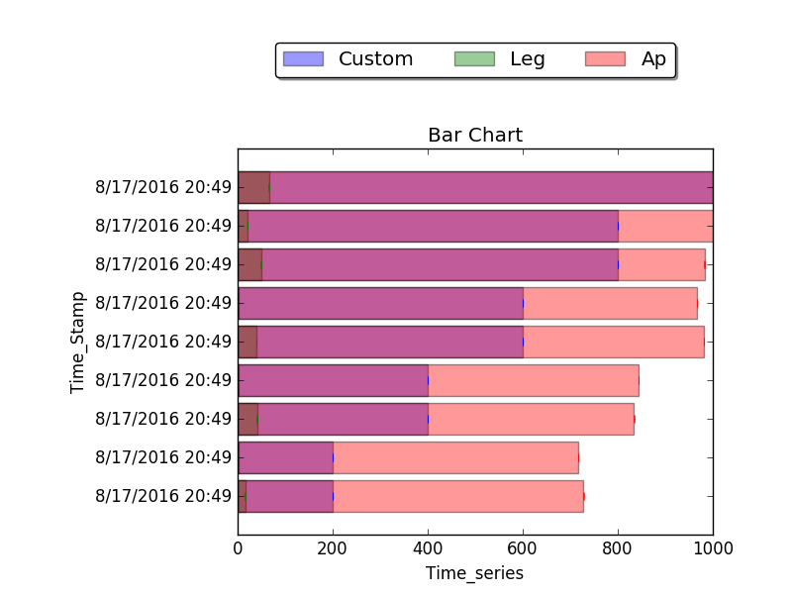
CSV Plotter User Manual
Label1: P30 / Color: P26
Title: P24
Y_access_label: P29
x_range: P25
X: P27

Slide 32
CSV Plotter User Manual
Program Execution Guide

Slide 33
CSV Plotter User Manual
Program Execution Guide:
Windows Users:
Configure the program by changing the configuration file, please see the Configuration File Guide. Page 6

Slide 34
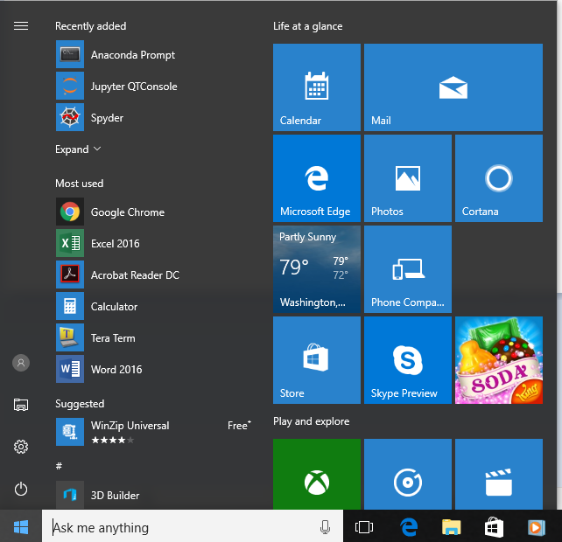
CSV Plotter User Manual
Open an Anaconda prompt terminal

Slide 35
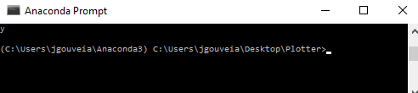
CSV Plotter User Manual
Change the directory to the file path containing the program.

Slide 36
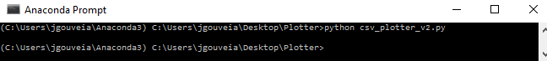
CSV Plotter User Manual
To execute the program type: python csv_plotter_v2.py
The resulting graph will pop up on screen and the png file will be saved to the same folder that python program is located Please note: The program will continue to run until the graph image is closed. In the case of plotting both a line graph and bar graph at the same time, the bar graph will appear after closing the line graph.

Slide 37
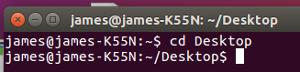
CSV Plotter User Manual
Ubuntu/Linux users:
Configure the program by changing the configuration file, please see the Configuration File Guide. Page 6
Open a terminal
Change the directory to the file path containing the program.

Slide 38
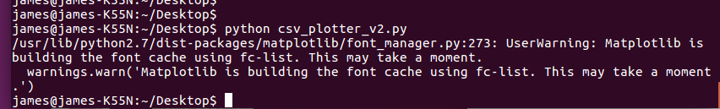
CSV Plotter User Manual
To execute the program type: csv_plotter_v2.py
The resulting graph will pop up on screen and the png file will be saved to the same folder that python program is located. Please note: The program will continue to run until the graph image is closed. In the case of plotting both a line graph and bar graph at the same time, the bar graph will appear after closing the line graph.

Slide 39
Thank You

